Slide 1


Green Pace
Security Policy Presentation
Developer: Anthony Lee

Slide 2

OVERVIEW: DEFENSE IN DEPTH
Defense in depth is the philosophy that information security mechanisms are carefully and thoughtfully layered in ordered to create a strong protection against risks and possible vulnerabilities in a system.

Slide 3
THREATS MATRIX
LIKELIHOOD | SEVERITY | Severity
 | LOW | MEDIUM | HIGH
UNLIKELY | STD-006-CLG | STD-008-CPP | STD-001-CPP
PROBABLE | STD-007-CPP |  | STD-002-CPP STD-004-CPP STD-009-CPP STD-010-CPP
LIKELY |  |  | STD-003-CPP STD-005-CPP

Slide 4
10 PRINCIPLES
Validate Input Data
STD-001-CPP
STD-002-CPP
STD-003-CPP
STD-004-CPP
STD-006-CPP
STD-009-CPP
STD-010-CPP
Heed Compiler Warnings
STD-005-CPP
STD-007-CPP
STD-009-CPP
STD-010-CPP
Architect and Design for Security Policies
STD-004-CPP
STD-005-CPP
STD-006-CPP
STD-008-CPP
Keep It Simple
STD-001-CPP
STD-002-CPP
STD-008-CPP
Default Deny
Adhere to the Principle of Least Privilege
Sanitize Data Sent to Other Systems
STD-003-CPP
STD-004-CPP
Practice Defense in Depth
Use Effective Quality Assurance Techniques
STD-006-CPP
STD-009-CPP
STD-010-CPP
Adopt a Secure Coding Standard
STD-005-CPP
STD-006-CPP
STD-007-CPP
STD-008-CPP
STD-009-CPP
STD-010-CPP

Slide 5
CODING STANDARDS
Label | Rule | Severity | Likelihood | Remediation Cost | Priority | Level
STD-005-CPP | Memory Protection | High | Likely | Medium | High (18) | 1
STD-003-CPP | String Correctness | High | Likely | Medium | High (18) | 1
STD-004-CPP | SQL Injection | High | Probable | Medium | High (12) | 1
STD-002-CPP | Data Value | High | Probable | Medium | High (12) | 1
STD-009-CPP | Containers | High | Probable | High | Medium (6) | 2
STD-010-CPP | Expressions | High | Probable | High | Medium (6) | 2
STD-007-CPP | Exceptions | Low | Probable | Medium | Low (4) | 3
STD-001-CPP | Data Type | High | Unlikely | High | Low (3) | 3
STD-008-CPP | Object Oriented Programming | Medium | Unlikely | Medium | Low (4) | 3
STD-006-CLG | Assertions | Low | Unlikely | High | Low (1) | 3

Slide 6
ENCRYPTION POLICIES
Encryption in rest: Protects stored data not in use
Examples: Hard drives, phones, laptops, etc.
Encryption at flight: Protects data that is moving
Examples: Sending emails
Encryption in use: Protects data that is created, changed, or in-use
Examples: Reading data documents, modifying data
Source: https://digitalguardian.com/blog/data-protection-data-in-transit-vs-data-at-rest

Slide 7
TRIPLE-A POLICIES
Authentication: The process of verifying the identity of a user
Ensures a person is who they claim to be
Authorization: The process of checking and granting permissions to a user after they successfully been authenticated into the system
What a user can and cannot access within a system
Accounting: The process of logging and accounting for the digital well-being of the system and its data
Log of all activity on a system
Source: https://www.techtarget.com/searchsecurity/definition/authentication-authorization-and-accounting

Slide 8
Unit Testing
Unit testing: the process of verifying and validating components of a program or application in order to ensure the app will act and respond as intended
Testing is done with Google Test (gtest)
https://github.com/google/googletest/
Source: https://www.techtarget.com/searchsoftwarequality/definition/unit- testing#:~:text=The%20main%20objective%20of%20unit,find%20in%20later%20testing%20stages

Slide 9
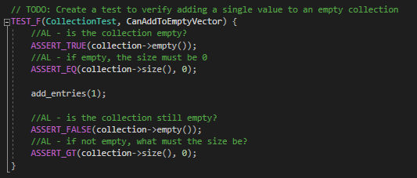
Test: CanAddToEmptyVector
code
output

Slide 10
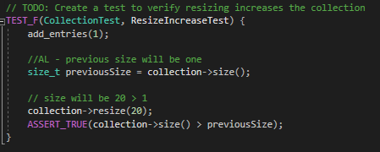
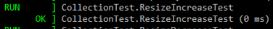
Test: ResizeIncreaseTest
code
output

Slide 11
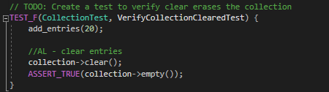
Test: VerifyCollectionClearedTest
code
output

Slide 12
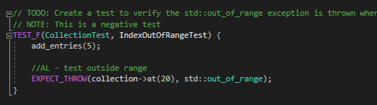
Test: IndexOutOfRangeTest
code
output

Slide 13
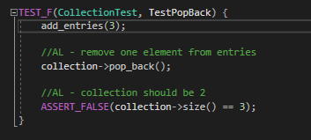
Test: TestPopBack
code
output

Slide 14

AUTOMATION SUMMARY

Slide 15
TOOLS
“DevSecOps stands for development, security, and operations. It's an approach to culture, automation, and platform design that integrates security as a shared responsibility throughout the entire IT lifecycle.”
RedHat.com
Tools:
CPPCheck: static code analysis (https://cppcheck.sourceforge.io/)
Clang: front-end compiler (https://clang.llvm.org/)
Parasoft: automated testing suite (https://www.parasoft.com/)

Slide 16
RISKS AND BENEFITS
Risk of waiting:
Harm to data
Harm to customer trust
Financial cost
Potential future damages of multiple attacks
Benefits of early action:
Mitigate possible damage
Prevent threats
Create structure and consistency in security
Reduce possible testing overhead
Example Case: Yahoo
In August of 2013, an attack on Yahoo led to more than 3 billion user accounts had been accessed by a hacking group. As Yahoo was in the middle of selling its main internet business to Verizon, this attack lost Yahoo $300 million on the deal after disclosing the attack.
Source: https://www.csoonline.com/article/2130877/the-biggest-data-breaches-of-the-21st-century.html

Slide 17
RECOMMENDATIONS
This policy is the start and foundation of security at Green Pace
However, every policy need to be subject to regular review and updates as threats are constantly evolving and improving
Waiting for an attack before acting leads to costing more than the upfront cost of being prepared beforehand
Annual checks from an outside, third-party source, such as a white hat security firm, will give the security a real-world test to find possible vulnerabilities
To ensure security is consistently at the forefront of progress, do not leave security until the end of development. Instead, early application of these policies will promote better security

Slide 18
CONCLUSIONS
Adopting best practices and coding standards, defense in depth, constant consideration to potential attacks and their motives, and keep a “zero-trust” policy towards security and prevention throughout development will help to transform DevOps into DevSecOps at Green Pace.

Slide 19
REFERENCES
Lord, N. (2022, November 28). Data Protection: Data in transit vs. data at rest. Digital Guardian. Retrieved December 10, 2022, from https://digitalguardian.com/blog/data-protection-data-in-transit-vs-data-at-rest
What is DevSecOps? Red Hat - We make open source technologies for the enterprise. (2022). Retrieved December 10, 2022, from https://www.redhat.com/en/topics/devops/what-is-devsecops
TechTarget. (2019, August 15). What is unit testing? definition from whatis.com. Software Quality. Retrieved December 4, 2022, from https://www.techtarget.com/searchsoftwarequality/definition/unit- testing#:~:text=The%20main%20objective%20of%20unit,find%20in%20later%20testing%20stages.
TechTarget. (2010, November 16). What is authentication, Authorization, and accounting (AAA)?: Definition from TechTarget. Security. Retrieved December 10, 2022, from https://www.techtarget.com/searchsecurity/definition/authentication-authorization-and-accounting
Hill, M., & Swinhoe, D. (2022, November 8). The 15 biggest data breaches of the 21st Century. CSO Online. Retrieved December 10, 2022, from https://www.csoonline.com/article/2130877/the-biggest-data-breaches-of-the-21st- century.html

